Slide 1
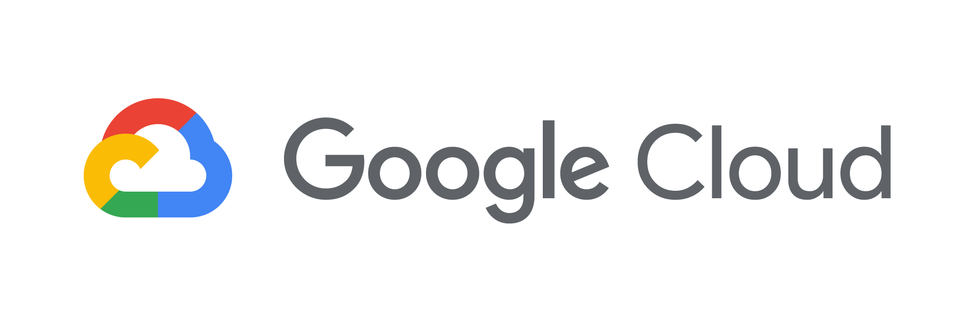
Globant
Incremental Data Movement
Pull Model
Rest API Calls to Composer

Slide 2
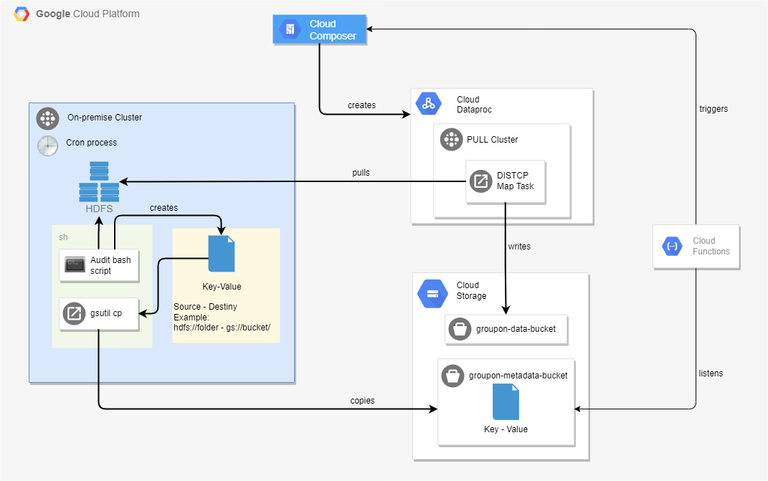
On the on-premise cluster a shell script runs to validate file changes on the desired HDFS directories. For the changes detected, it will write the directory name in a key-value file.
Using gsutil cp tool as part of the Google Cloud SDK (installed in the on-premise cluster) the key-value file is copied to Google Cloud Storage.
A Cloud Function is triggered when the file is written to the bucket, which thru a REST APIs call triggers a DAG in Google Cloud Composer.
Google Cloud Composer runs a DAG that submits a DISTCP job per line in the key-value file against a PULL cluster-pool that will DISTCP the data to Google Cloud Storage.
1
4
1
2
3
3
2
4
The Google Cloud Function was only incorporated to this architecture diagram to cover the ability to perform REST API calls to Google Cloud Composer, which was asked by Groupon on a previous session to validate the technical viability to do so. Google Cloud Composer can directly check for a file existence in a bucket and trigger a DAG run without the need of a Cloud Function.

